Slide 1
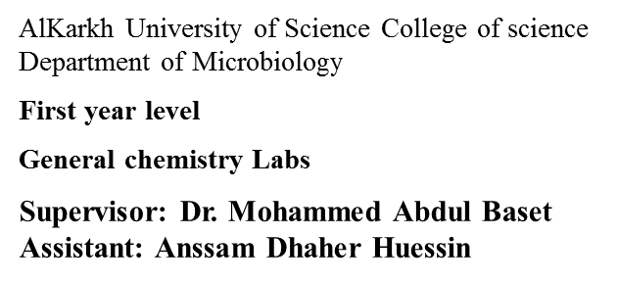
Lab -4-
Preparation of standard solution from liquid solutions
Diluting Solutions
> Many laboratory chemicals such as acids are purchased as concentrated solutions (stock solutions).
> More dilute solutions are prepared by taking a certain quantity of the stock solution and diluting it with water.
> A standard solution is one with an accurate, known concentration. This is also known as a stock solution.
• These are used as reactant solutions.
• They usually have a higher concentration than is needed for creating solutions and therefore must be diluted.
> After diluting a solution, the concentration of the solution changes.
> Relationship between molarity, density and weight percent is:
Where M: molarity (mol/L), d: density (g/ml), Wt: weight percent (%) and Mw: molecular weight.
> When a solution is diluted, the concentration of the new solution can be found using:
Don’t forget the equation for molar concentration! (c = n/V)
C = concentration in moles per litre n = number of moles V = volume in litres
How to make 0.1 M Sulfuric Acid (H2SO4) Solution from concentrated one
15

Slide 2
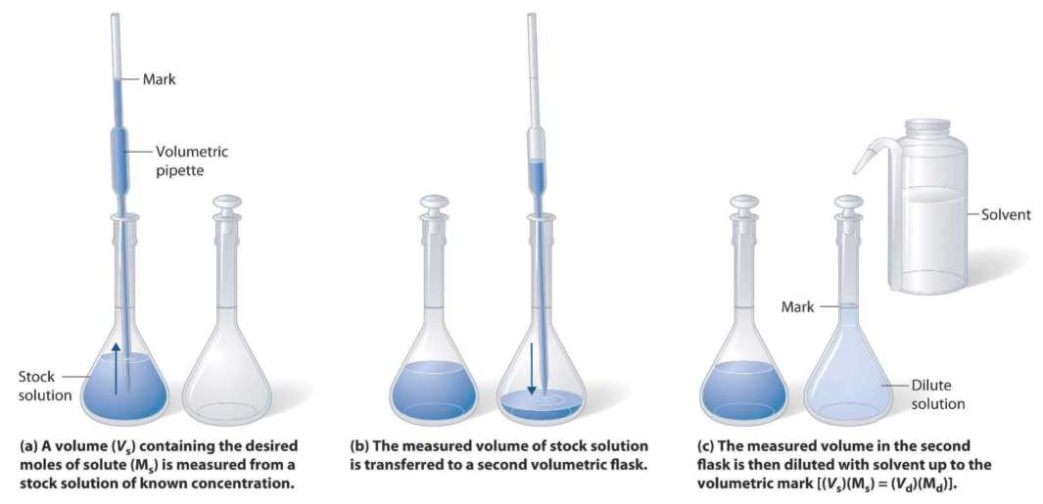
- Use a pipet to deliver a volume (Vx) of the concentrated solution (H2SO4) (Mx) to prepare (diluted) 100, 250 and 500 ml of 0.1 M sulfuric acid solution.
- Add solvent (distilled water) to the line on the neck of the volumetric flask.
- Mix well.
- Mathematically the relationship of diluting solution can be shown in the equation:
M(C), x V = M(C)₂ x V
1 = initial (concentrated) 2 = final (diluted)
Where:
M(C)₁ = Initial concentration or molarity M (mol/L). V1 = Initial volume (ml)
M(C)₁ = Final concentration or molarity M (mol/L). V1 = Final volume (ml)
Why is acid always added to water, and not the reverse?
o A large amount of heat is released when strong acids are mixed with water. Adding more acid releases more heat.
o If you add water to acid, you form an extremely concentrated solution of acid initially. So much heat is released that the solution may boil very violently, splashing concentrated acid out of the container!
o If you add acid to water, the solution that forms is very dilute and the small amount of heat released is not enough to vaporize and spatter it. So Always Add Acid to water, and never the reverse.
16

